Slide 1
POST Study Project
Mac AI Projects Expo
Project Leads: Hafez Issa, Nicholas Mateus
Project Members: Aidan Mathew, Omar Muhammad, Leiah Nay, Emily Perica, Edward Zhuang

Slide 2


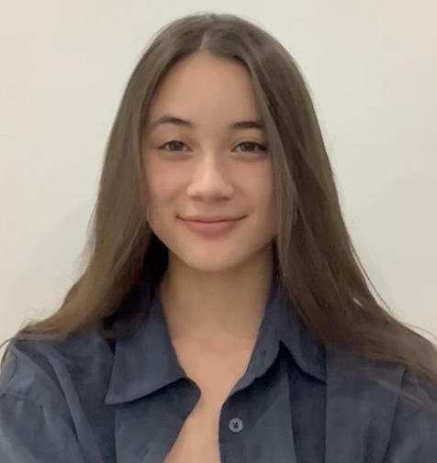




Hafez Issa
Software & Biomedical Engineering IV
Aidan Mathew
Computer Engineering & Management II
Leiah Nay
Computer Science I
Edward Zhuang
Software Engineering III
Nicholas Mateus
Computer Engineering IV
Omar Muhammad
Software Engineering ll
Emily Perica
Software Engineering II

Slide 3
Table of Contents
Background + Motivation
The Goal
Ethical Consideration
Our Process
Data Cleaning
Feature Engineering: Labelling Patients
Choosing an ML Model
ML Solution
Support Vector Machines
Results
Next Steps
Conclusion

Slide 4
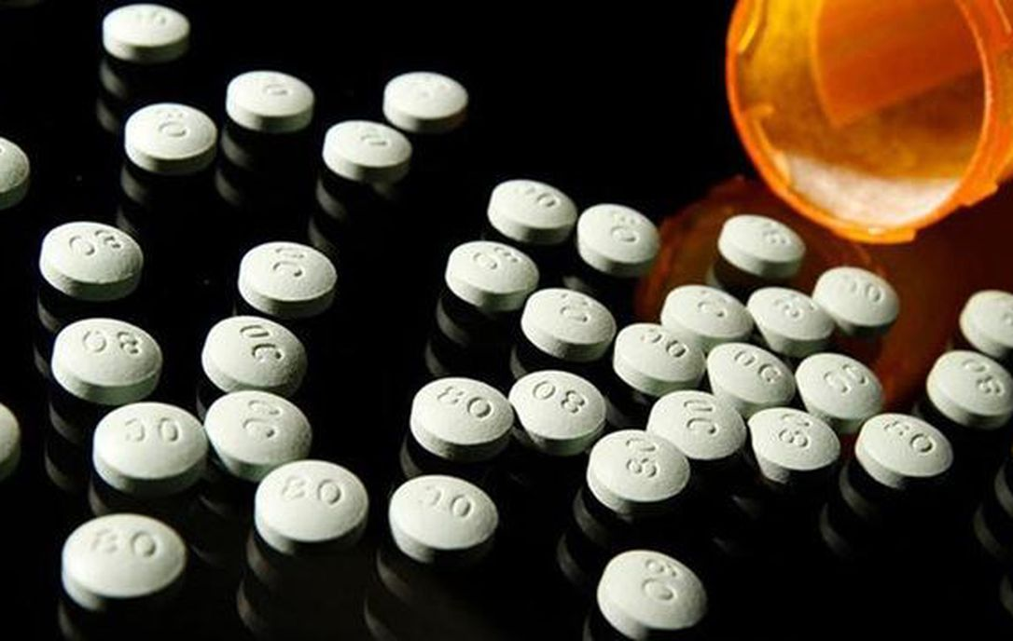
Background + Motivation
Tackling the opioid epidemic in Hamilton– in 2019, Hamilton’s opioid-related death rate was 75% higher than the provincial rate
Collaboration project with McMaster’s Faculty of Health Sciences
Using data from their POST study under Dr. Samaan (Pharmacogenetics of Opioid Substitutions Treatment Response study)
Notes:
(Emily)
Pharmacogenetics - the branch of pharmacology concerned with the effect of genetic factors on reactions to drugs.
hamilton.ca/public-health/reporting/hamilton-opioid-information-system

Slide 5
The Goal
Successfully train a classification machine learning model to predict whether a patient addicted to opioids will make a full recovery (using data from the POST study)
Keep ethics + values in mind throughout duration of project
Notes:
(Emily)
The data that was collected pertains to various aspects of the patients’ personal lives in order for the researchers to draw conclusions based on what may be a contributing factor to recovery. Various ethical considerations are necessary when dealing with real people

Slide 6

Ethical Considerations
Needed a certificate from the Hamilton Integrated Research Ethics Board before being granted access to this data
Patients are organized via ID numbers rather than name
The dataset includes some very sensitive information; important to recognize there are real people behind the numbers
Notes:
(Omar)
In order to maintain patient anonymity, names were replaced with ID numbers. Before even being provided with access to the data, the researchers had us complete a chart review tutorial from the Hamilton Integrated Research Ethics Board to ensure our commitment to patient safety.

Slide 7
Overall Process
Spent a lot of time cleaning up data (using pandas, numpy)
Created a labelling system to label successful patients vs. unsuccessful patients by analysing presence of opioids in urine over time
Had to cut 3809 rows down to 1735; 2118 columns down to 428
Rows representing patients, columns representing data variables
Notes:
(NICK)
Our first task was to clean up the data set we were provided with. We actually spent majority of our time within our project on this task, as there were many factors to consider
To do the data cleaning we developed and tuned our skills using numpy and pandas (which are common data manipulation python modules)
We also went on to create a labelling system to differentiate between “successful” and “unsuccessful” patients based on the concentration of opiods in their urine over different time periods
This feature engineering step will be discussed more in a further slide
In the end we cut nearly half the patients out of the data set since the data actually consisted of 2 separate studies, and we felt that it would be simpler and more comprehensive if we stuck to only 1 data study
We also cut down the number of data columns significantly, this was done by analyzing the columns that were found to be either mostly empty, mostly zeros, or contain text string, as we wanted to keep everything strictly to numerical data. In the future, natural language processing, or further investigations can be made to re-incorporate any string text into our model.

Slide 8





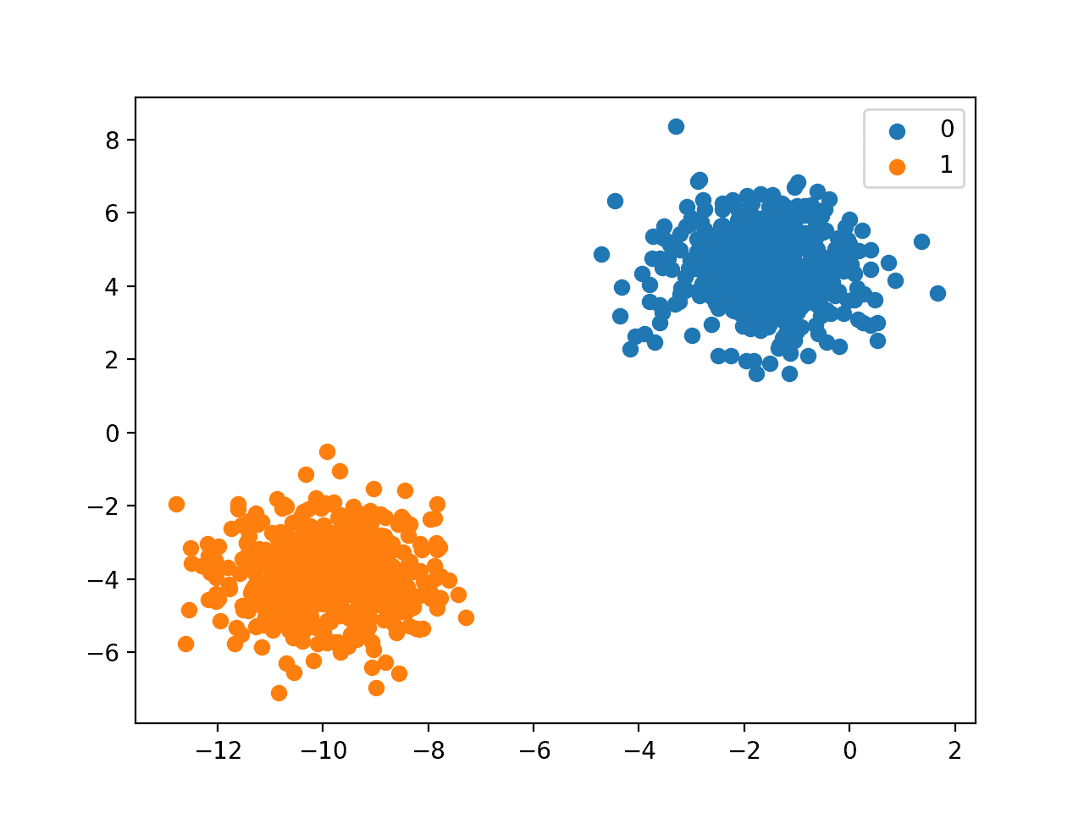
Bigger Picture
Data Cleaning
Feature Engineering
Classifying and Predicting
Notes:
(NICK)
This shows the big picture and work flow of the project
Starting with data cleaning and feature engineering as mentioned, followed by data parsing, plotting, and analysis through the use of pandas, numpy, and jupyter notebooks
Lastly the cleaned data was fed into our models, which will discussed later on.

Slide 9

Data Cleaning
Wrote Python scripts using pandas to help remove irrelevant variables, fix noisy and inconsistent data, convert data to useful types, etc.
Created numerous iterations of dataset, until we had a “final” clean set on which we could train a machine learning model
Notes:
(Edward)
A major part of the project was to clean up the data that was given to us, so that it could actually be used to train/fit a machine learning model. Key things we were looking to do were eliminating columns with non-numerical data (like strings), fixing inconsistent data entries, and getting rid of irrelevant data to the study. Something we ran into were data entries that should be numerical but sometimes had units attached to them. The main technologies we used to clean up our data were Python and the library pandas, which we used to efficiently clean the data. Throughout the process, we created many iterations of the original dataset, until we had a finalized one which we used to train the machine learning model.

Slide 10
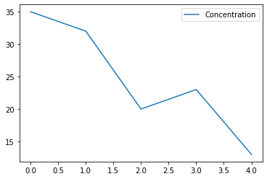
Feature Engineering: Labelling Patients
Given patient data on opioid concentration in urine over multiple discrete time intervals, we drew a line of best fit and classified patients with a significantly negative slope as successfully treated
For this, we used numpy as well as matplotlib to analyse our findings
Opioid concentration in urine
Time of urine test
Notes:
(Edward)
For the project, we had to create a labelling system for patients to determine whether or not they were successfully weaning off of opioids. As this is not an objective thing we had to decide ourselves by what metric we wanted to classify patients as successful or unsuccessful. We decided to use patient data on opioid concentration in urine over multiple discrete time intervals (those being the start date, a year from then, and intervals of 3 months between those), as that would be an indicator of how much they still rely on opioids after a lot of time has elapsed.
[read off slides]
In this graph, we can see that the line of best fit is quite negative, so our labelling system would likely classify this patient as successfully weaning off of opioids.

Slide 11
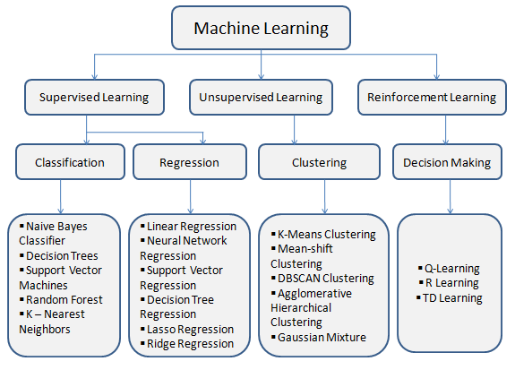
Choosing an ML Model
Our task is a classification problem, because we want to classify patients based on a set of inputs (patient dataset), into discrete categories (successful treatment or not)
We decided to use a Support Vector Machine (SVM) because they are most effective in high dimensional spaces
Notes:
(Edward)
As a classification problem, we were mostly considering a Logistic Regression or a Support Vector Machine.

Slide 12
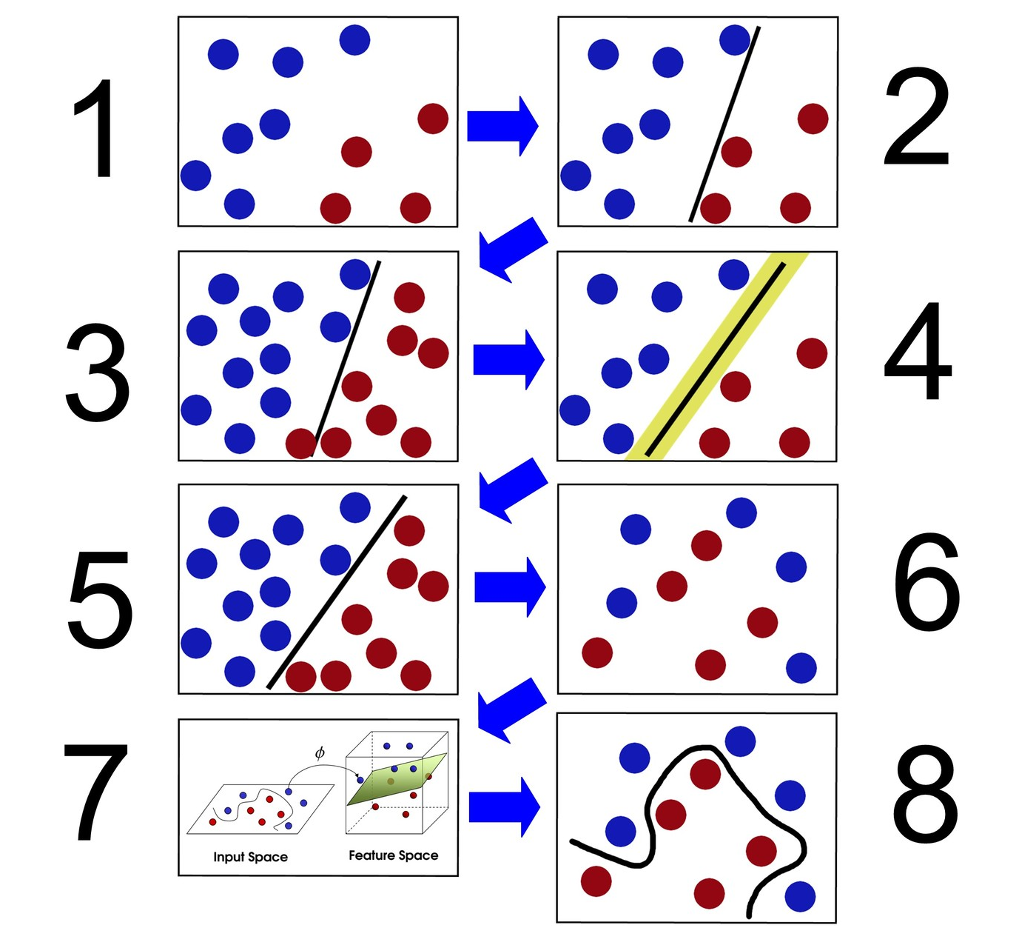
Support Vector Machines
Notes:
Here’s a quick overview of how SVMs work, using this diagram we can explain the logic behind binary classification.
So
We have 2 colors of balls on the table that we want to separate
We can draw a line through them and separate them just fine
Let’s say someone adds more balls to the table, using the same line we get a decent result however now there is probably a better place to draw that line
Now a friend comes in and completely messes up the configuration and it’s almost impossible to draw a line in this space
You flip the table, throwing the balls in the air and take a freeze frame, this allows us to draw a sheet or plane to split up our two classes
We can then reduce the dimensionality and see a curvy line that does a good job of classifying
Hafez

Slide 13
Results
model = SVC()
model.fit(X_train, y_train)
pred = model.predict(X_test)
print(confusion_matrix(y_test, pred, labels=[1,0]))
True Positives
False Positives
[[43 81]
[20 89]]
False
Negatives
True Negatives
Notes:
Hafez
That said, we used an SVM to train and fit on a sample of our dataset. Right off the bat we were not too happy with the results, but this was actually expected. Machine learning is about iterative prototyping. We can see that we get a significant amount of False Positives and True Negatives. In the context of our problem this is not the ideal situation. The model has a higher chance of classifying a patient as Positively recovered, even when the patient is not ready to be released from the program. In an ideal situation we want to reduce the number of False Positives because we would rather keep our patients safe and supervised in our study. A false negative in this situation does not harm anyone as that just means a patient has truly recovered from the addiction but is still a part of the program. The lesson learned in this situation is the trade off between recall and precision. Depending on the context of the problem we might favour having more false positives than negative and vice versa.

Slide 14
Next Steps
Better understand data set
Consider as many features as possible, allowing better use of all the data available
The implementation of Neural Networks
This can be more effective in classifying outcomes
Work more closely with the POST study group
Patient-desired outcomes might be more complex than a simple “did the patient wean off of opioids” so we would try to classify more patient-desired outcomes
Notes:
Aidan

Slide 15
Conclusion
Lessons learned:
Importance of data cleaning
Software development and machine learning best practices
Agile Software Development
Project management practices
Industry tools (Git etc.)
Did we reach our goal?
Notes:
Aidan

Slide 16
Thank you!

